Slide 1
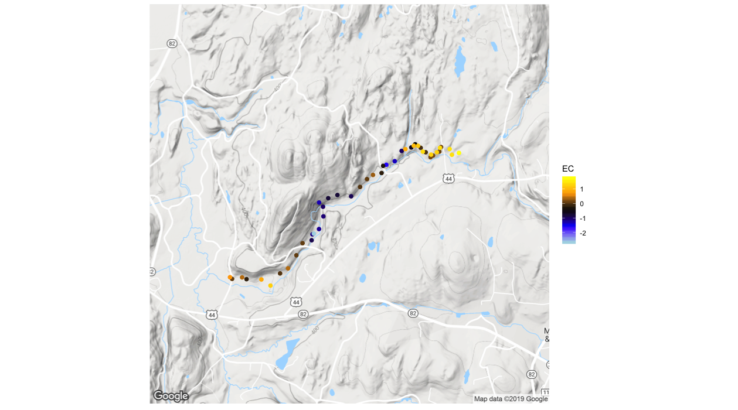
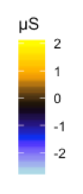
Reach Normalized Electrical Conductivity (μS)
Contrast C
= High Angle
Fault
Contrast D
Zone 3-1
Contrast E
High Angle
Fault Zone
Zone 3-2
Zone 3-3
Zone 3-4
0.5
1.0 Km

